Slide 1

BY
AZKA KARIM

Slide 2

What is Upwork?
Founded in 2015
18+ million freelancers, 5+ million clients
$3.8 billion+ earned by freelancers annually (2024 stats)
Available in 180+ countries

Slide 3
How Upwork Works (Simple Flow)

Slide 4

Types of Work on Upwork
Categories icons: Development & IT, Design & Creative, Writing, Customer Support, Sales & Marketing, Accounting, etc.
Fixed-price vs Hourly projects

Slide 5


Slide 6


Slide 7


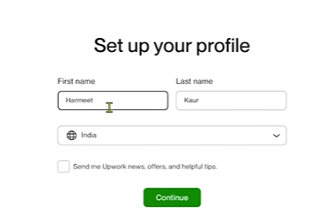
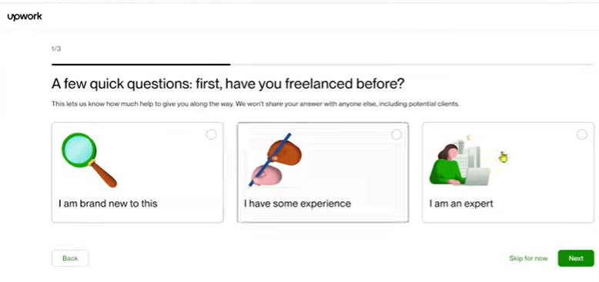

Slide 8
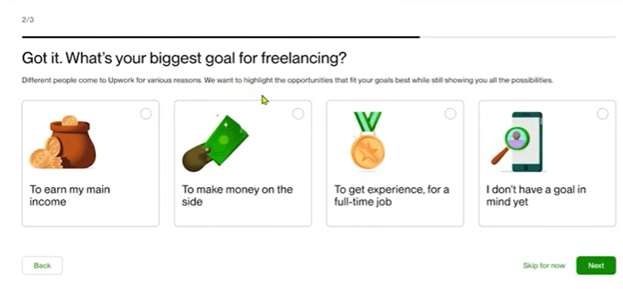
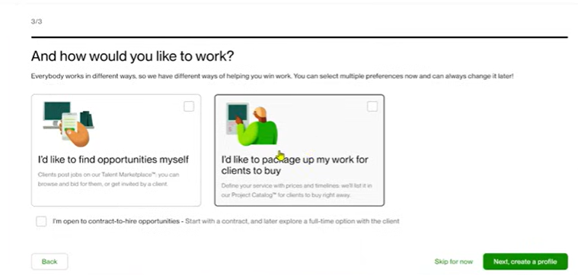

Slide 9
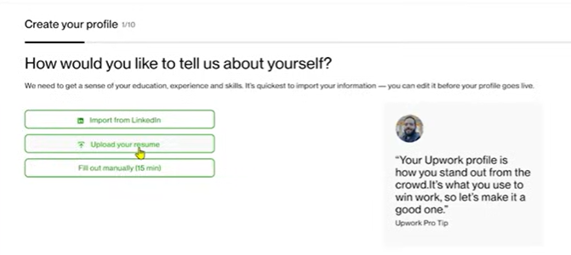

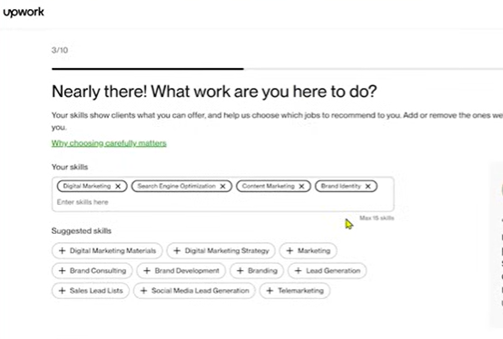

Slide 10
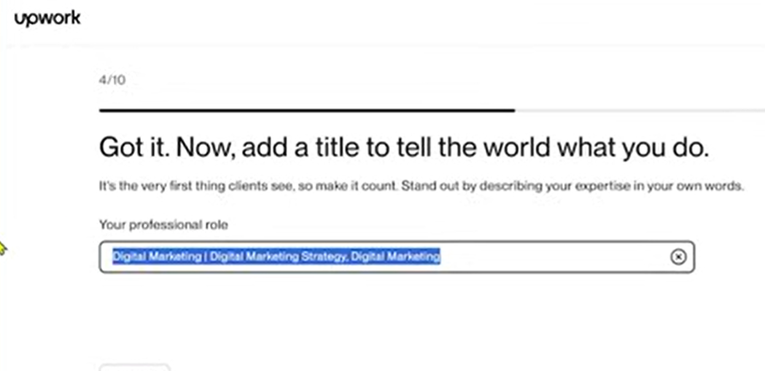
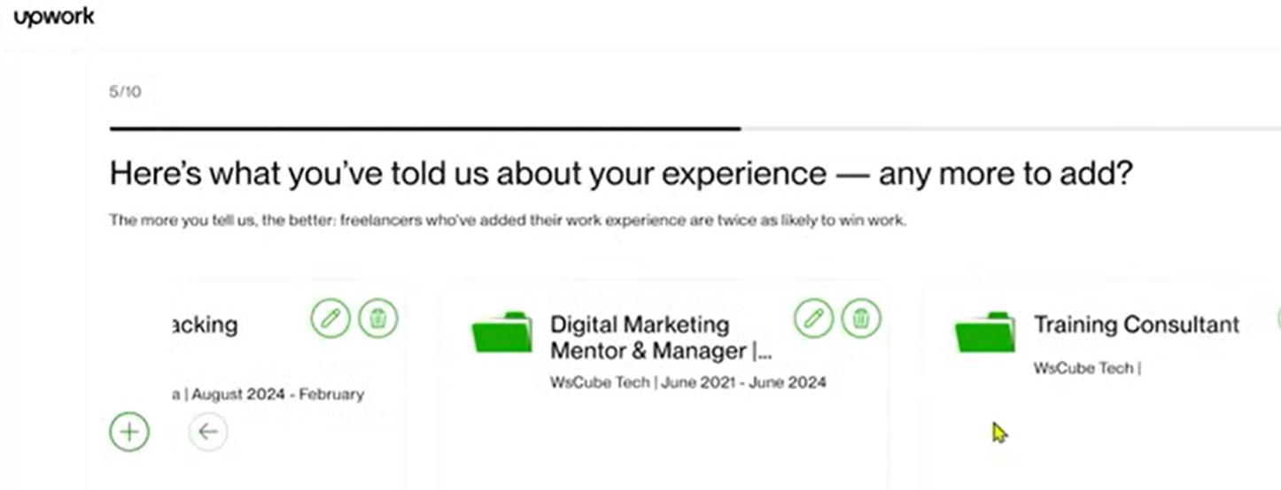

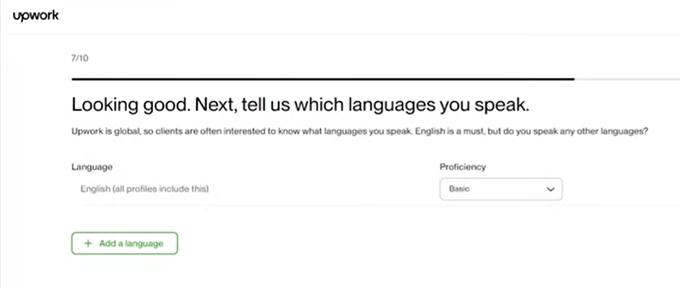

Slide 11

